Slide 1
Cardiovascular disease Risk Prediction
Pujita Sunnapu
20210701019
B.Sc.(Hons.) Computer Science with specialization in data Science

Slide 2
Section 1: Data Mining Analysis

Slide 3
INTRODUCTION
Cardiovascular diseases (CVDs) continue to pose a significant global health challenge, with profound implications for individuals and healthcare systems. As one of the leading causes of morbidity and mortality worldwide, understanding and predicting the risk factors associated with CVDs is imperative for effective prevention and intervention strategies. This project addresses the critical need for accurate and personalized risk prediction models for cardiovascular diseases.
The significance of this project lies in the potential to leverage advanced machine learning techniques to identify subtle yet impactful patterns within a comprehensive dataset obtained from healthcare institutions. By predicting cardiovascular disease risks, we aim to empower healthcare professionals with timely and actionable insights, enabling targeted interventions and personalized patient care. The relevance of this project extends beyond academic curiosity; it has practical implications for enhancing public health efforts, optimizing resource allocation, and improving patient outcomes.
With the prevalence of cardiovascular diseases on the rise globally, there is a growing urgency to refine and innovate risk prediction methodologies. This project responds to this imperative by combining the power of data-driven predictive modeling with the richness of a manually collected dataset. The outcomes of this research have the potential to reshape the landscape of cardiovascular disease prevention, ushering in a new era of proactive and personalized healthcare strategies.

Slide 4
Steps
1. Data Loading and Exploration
2. Data Overview
3. EDA
4. Data Preprocessing
5. Correlation Analysis
6. Class Variable Analysis
7. Data Balancing
8. Outlier Removal
9. Modeling

Slide 5
Data Loading and Exploration
Data Loading, Exploration, and cleaning
2 / 2
Libraries like NumPy, Pandas, Matplotlib, and Seaborn are imported for data analysis and visualization.
The dataset ('CVD_cleaned.csv') is loaded into a Pandas DataFrame named `df`.
The first few rows of the dataset are displayed to provide an initial overview.
The shape of the dataset is shown, indicating the number of rows and columns.
Null values are checked, and the dataset is cleaned by removing rows with null values and duplicates.
The final cleaned dataset is stored in the `data` variable.
The updated shape of the dataset after cleaning is displayed.

Slide 6
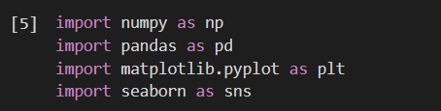
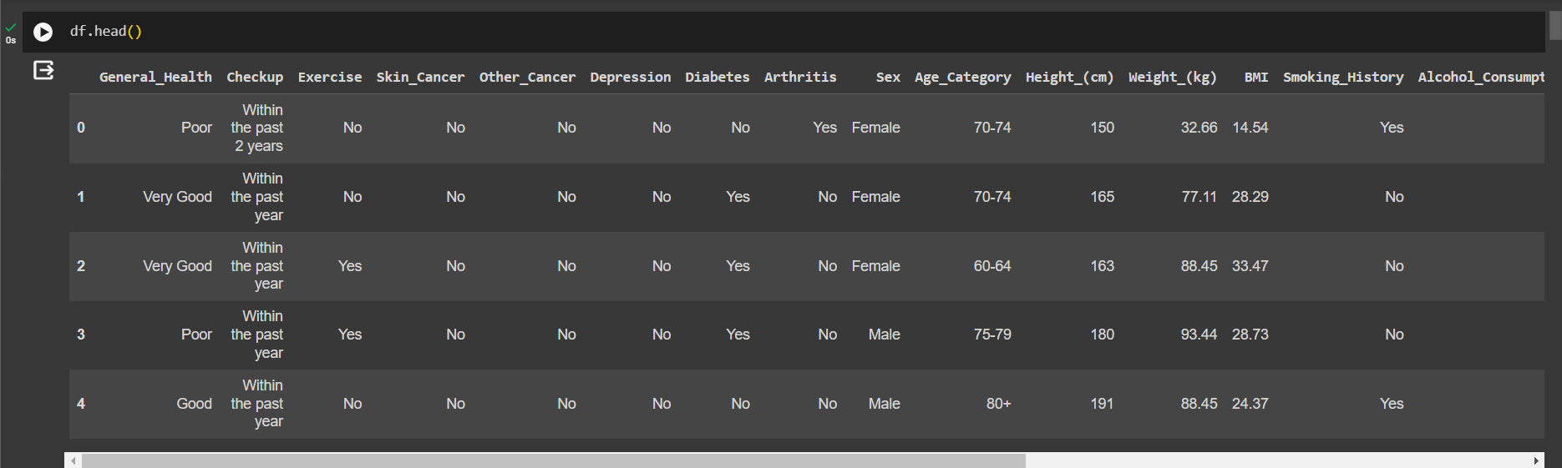
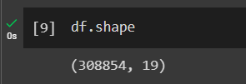

Slide 7
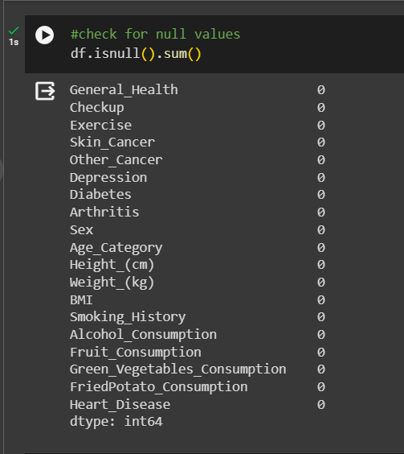
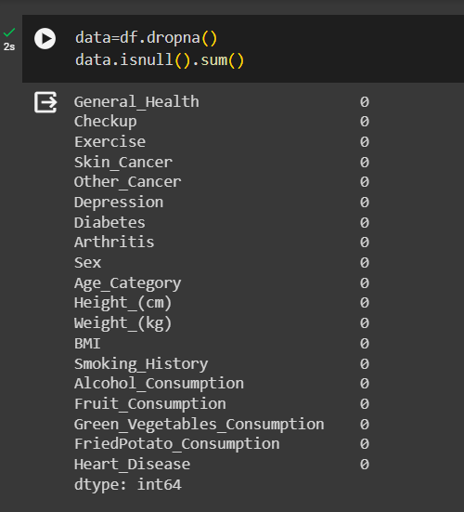

Slide 8
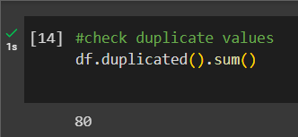
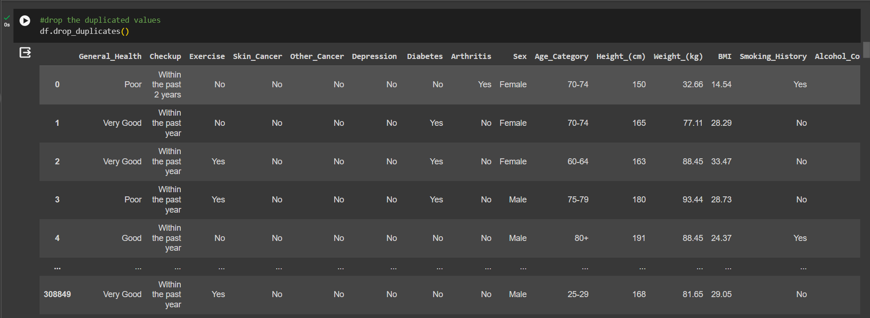

Slide 9
Exploratory Data Analysis

Slide 10
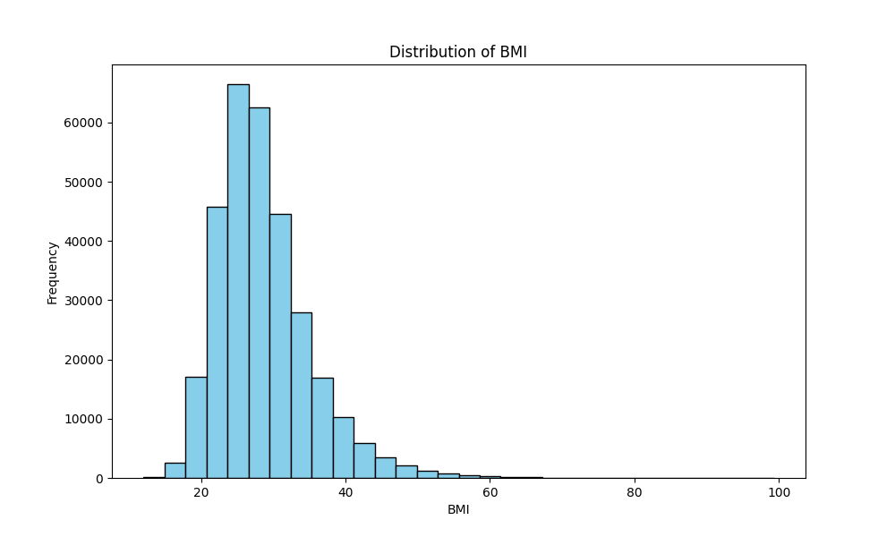
Histogram for BMI:
Purpose: This histogram shows the distribution of BMI (Body Mass Index) in the dataset.
Outcome: It provides an overview of the distribution of BMI values, indicating whether the data is skewed, symmetric, or has multiple peaks. This information is useful for understanding the prevalence of different BMI ranges in the population.

Slide 11
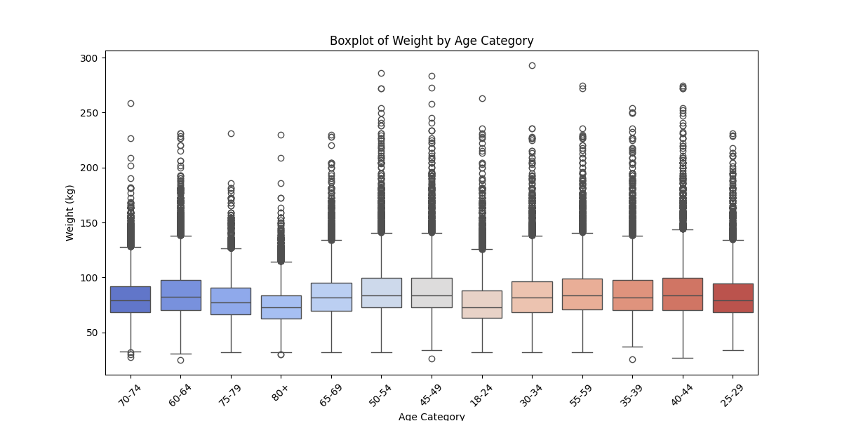
Boxplot for Age_category and Weight_(kg):
Purpose: The boxplot visualizes the distribution of weights across different age categories.
Outcome: It helps identify the central tendency, spread, and potential outliers in weight for each age category. This information can be valuable for understanding how weight varies across different age groups.

Slide 12
Data Preprocessing
Data preprocessing is a crucial step in preparing our dataset for machine learning models. This involves handling missing values, encoding categorical variables, and scaling features to ensure optimal model performance.
Label Encoding
Correlation Analysis
Class Variable Analysis
Balancing Classes with SMOTE
Outlier Removal

Slide 13
Label Encoding
Label Encoding is particularly useful when dealing with ordinal categorical data, where the order of categories holds significance. However, it may not be ideal for nominal categorical data where there is no inherent order.
In our dataset, certain features are categorical, requiring transformation into a numerical format for compatibility with machine learning algorithms. Label Encoding is a technique used to achieve this conversion.
Creating a Copy:
A copy of the original dataset (df) is created to preserve the raw data.
Label Encoder Initialization:
An instance of the LabelEncoder from scikit-learn is created.
Iterative Encoding:
A loop iterates through each column of object data type (categorical variables) in the dataset.
The fit_transform method of the LabelEncoder is applied to convert categorical values into numerical equivalents.

Slide 14
Correlation Analysis
Data Loading, Exploration, and cleaning
2 / 2
Correlation analysis plays a crucial role in uncovering relationships between different features within the dataset. In our project, we utilized the Pandas and Seaborn libraries in Python to calculate and visualize the correlation matrix.
The code calculates the correlation matrix using `df_encoded.corr()`, providing a numerical representation of how variables relate to each other.
The Seaborn heatmap (`sns.heatmap()`) is employed to visualize the correlation matrix, with annotations for clarity.
Colors in the heatmap represent the strength and direction of correlations; warm colors for positive correlations, cool colors for negative correlations.
This analysis aids in identifying potential multicollinearity and understanding which features may have the most significant impact on the target variable.

Slide 15
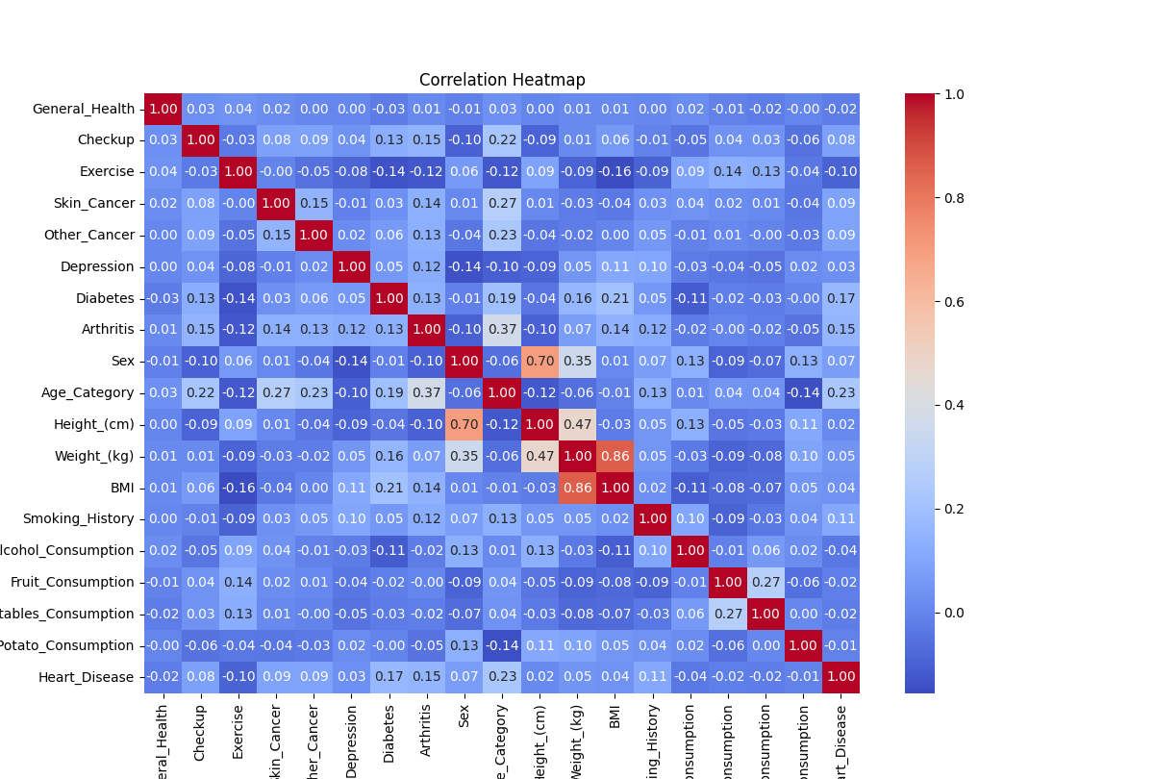

Slide 16

Class Variable Analysis
Data Loading, Exploration, and cleaning
2 / 2
In this phase of our project, we delved into analyzing the distribution of our target variable, 'Heart_Disease.' By employing Python and Pandas, we gained insights into the balance and prevalence of heart disease cases in our dataset.
The code snippet employs `value_counts()` to count occurrences of each unique class in the 'Heart_Disease' column.
The output reveals the distribution of cases, indicating the prevalence of individuals with and without heart disease.
Understanding the class distribution is crucial for addressing potential imbalances in the dataset, which can impact the performance of machine learning models. In our case, we noted an imbalance with a significantly higher number of instances without heart disease compared to those with heart disease.

Slide 17

Data balancing: SMOTE
In our project, we encountered a class imbalance in the 'Heart_Disease' variable. To mitigate this imbalance and enhance the model's predictive capabilities, we employed the Synthetic Minority Over-sampling Technique (SMOTE).
The code splits the dataset into features (`X`) and the target variable (`y`), separating predictors from the variable we aim to predict ('Heart_Disease').
We then instantiate the SMOTE object from the imbalanced-learn library and apply it using `fit_resample()` on our features and target variable.
SMOTE generates synthetic instances of the minority class to balance class distribution, thereby avoiding biased model predictions.
Balancing the dataset is critical for ensuring that the machine learning model is not skewed toward the majority class, resulting in more accurate predictions for both classes.

Slide 18
Outlier Removal
In the data preprocessing phase, we recognized the importance of addressing outliers to improve model performance. Leveraging the Interquartile Range (IQR) method, we identified and removed outliers from specific columns in our dataset.
The code identifies and removes outliers using the IQR method for specific columns (`selected_columns`).
It calculates the IQR (difference between the first and third quartiles) for each column and defines a threshold for identifying outliers.
A mask is created to mark rows with outliers in the selected columns.
Rows containing outliers are then removed from both the feature matrix (`X_train`) and the target variable (`y_train`).
The process ensures the removal of extreme values that may adversely affect model training and prediction accuracy.

Slide 19
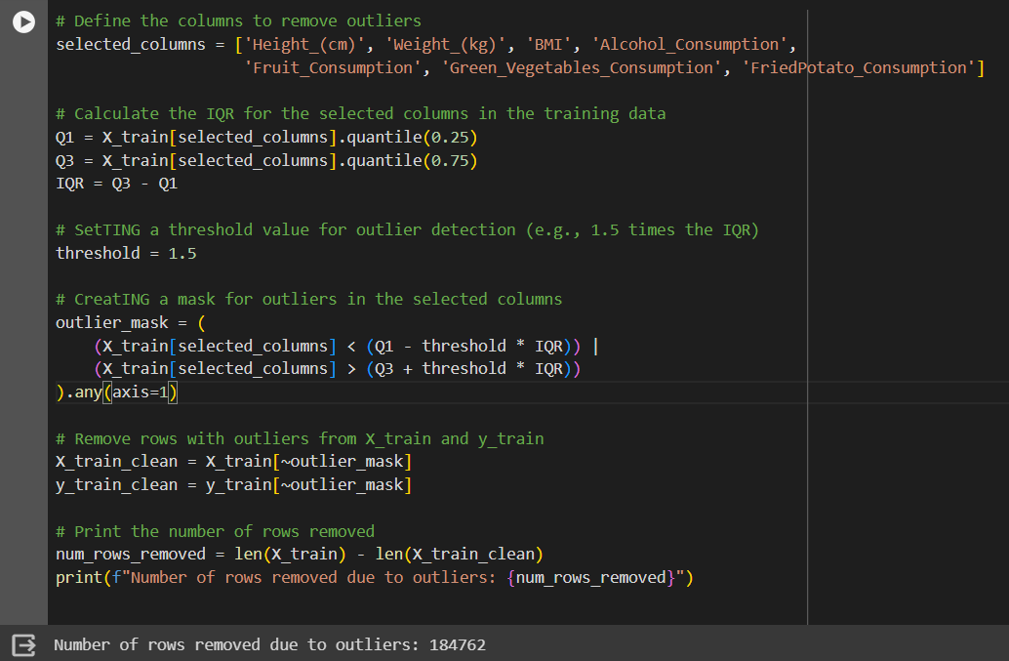

Slide 20
Section 2: Predictive Analytics

Slide 21
Linear Regression
In this phase, we transition from exploration to prediction, utilizing various machine learning models to gain insights into cardiovascular health.
1. Model Selection:
Linear Regression is chosen as a baseline model for its simplicity and interpretability.
2. Training the Model: The model is trained on the cleaned dataset (`X_train_clean` and `y_train_clean`).
3. Predictions and Evaluation: Predictions are made on the test set (`X_test`), and the model's performance is evaluated using mean squared error (MSE) and mean absolute error (MAE).

Slide 22
Logistic Regression
In this phase, we employed Logistic Regression as a predictive model to assess cardiovascular risk, and the resulting AUC curve provided insights into the model's discriminatory power.
1. Logistic Regression: Logistic Regression is chosen for its suitability in binary classification problems.
2. Training the Model: The model is trained on the cleaned dataset (`X_train_clean` and `y_train_clean`).
3. Predictions and Probabilities: Predictions and probabilities are obtained for the test set (`X_test`).
Interpretation:
The AUC score of 0.73 suggests a reasonable ability of the Logistic Regression model to discriminate between positive and negative instances.
The ROC curve visually represents the trade-off between sensitivity and specificity, guiding model evaluation and potential adjustments.

Slide 23
Decision Tree
The Decision Tree model exhibits substantial discriminatory power, as indicated by the ROC curve and an AUC score of 0.79.
1. Decision Tree: The Decision Tree model is trained on the cleaned dataset (`X_train_clean` and `y_train_clean`).
2. Predictions and Probabilities:
Predictions and probabilities are obtained for the test set (`X_test`).
3. AUC Score and Curve:
The Area Under the Curve (AUC) score is calculated using `roc_auc_score`.
The AUC curve is plotted using `roc_curve` to visualize the model's discrimination between true positives and false positives.
Interpretation:
The AUC score of 0.79 indicates that the Decision Tree model performs well in distinguishing between positive and negative instances.

Slide 24
Random forest
Random Forest, an ensemble of Decision Trees, is employed to harness the collective strength of multiple models. The impressive AUC score of 0.86 reflects heightened discriminatory capabilities.
1. Random Forest: Random Forest combines multiple Decision Trees to enhance predictive accuracy and generalization.
2. Training the Model: The model is trained on the cleaned dataset (`X_train_clean` and `y_train_clean`).
3. Predictions and Probabilities: Predictions and probabilities are obtained for the test set (`X_test`).
4. AUC Score and Curve:
The Area Under the Curve (AUC) score is calculated using `roc_auc_score`.
The AUC curve is plotted using `roc_curve` to visualize the model's discrimination between true positives and false positives.

Slide 25
Thank You

